Slide 1
Grade 4
November
Newsletter
RIS
2013-2014

Slide 2
Important Dates
November 6th is an Early Dismissal Day. Students are dismissed at 1:00pm.
November 22nd is a Teacher Inservice Day. No school for students!
November 29th is a Non Uniform Day and ES Parent Coffee.

Slide 3
HOMEWORK
All students should be reading 30 minutes or more each night, recording their book and time on their reading log.
Math, Science, and/or Social Studies may also be sent home each night/week for homework.
All students are expected to complete homework on time and submit it to their homeroom teacher DAILY or WEEKLY as specified.

Slide 4

Literacy
In Readers’ and Writers’ Workshops we have launched into a study of the genre of realistic fiction.
Readers are practicing the strategies of envisioning and predicting to better “Walk in the Character’s Shoes” and thereby deepen understanding and empathy. These reading strategies will also enhance our character development as we begin a new writing process.
In Writers’ Workshop writers are learning the defining characteristics of realistic fiction, how to generate ideas for our own stories, and how to create compelling, believable characters. We will choose one idea to develop and publish. Stay tuned for celebration time next month!

Slide 5
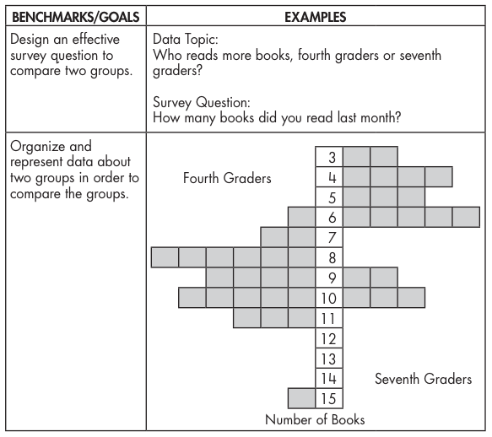
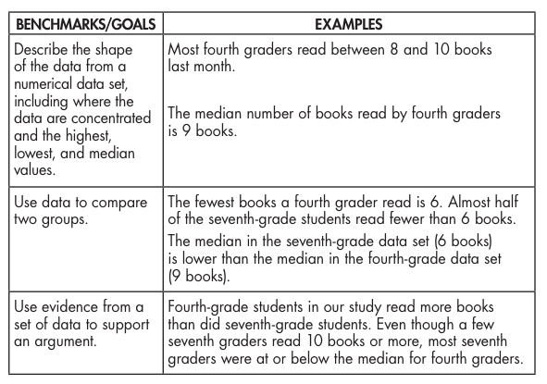
Math
Dear Families,
Grade 4 is continuing their investigation of data and probability.’ During this unit, students collect, represent, describe, and interpret data.Throughout the unit, students work toward these goals:

Slide 6
Science
The kids have jumped right into science with our unit on Earth Materials. They will explore the following concepts in Earth Science:
Mock Rocks—rock and mineral properties
Scratch Test—specific properties of minerals
Calcite Quest—presence of calcium/calcite in rocks
Take it for Granite—using mineral properties to find out which minerals are in the rock, granite

Slide 7
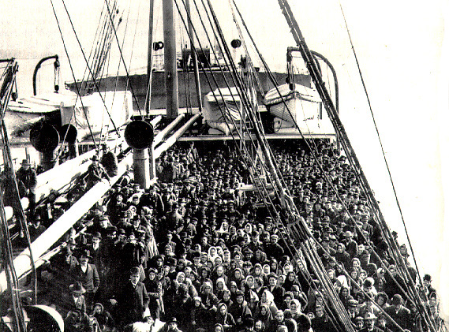
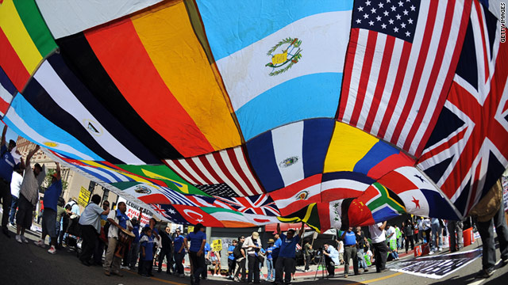
Social Studies
Immigration in the Past
Immigration Today
Our second unit in Social Studies will center our immigration. The essential questions are:
Why is knowing about the past important?
What effect does migration(or moving) have on my own life and others?
What connections can I make to my own family?
Social Studies Skills:
Tell events that have led to migration of people.
Identify the specific time periods and the historic impact of large migrations of people.
Describe the impact of cultural exchange between populations.
Identify the impact governments have on the migration of people.
Interpret and constructs timelines, graphs and charts.

Slide 8
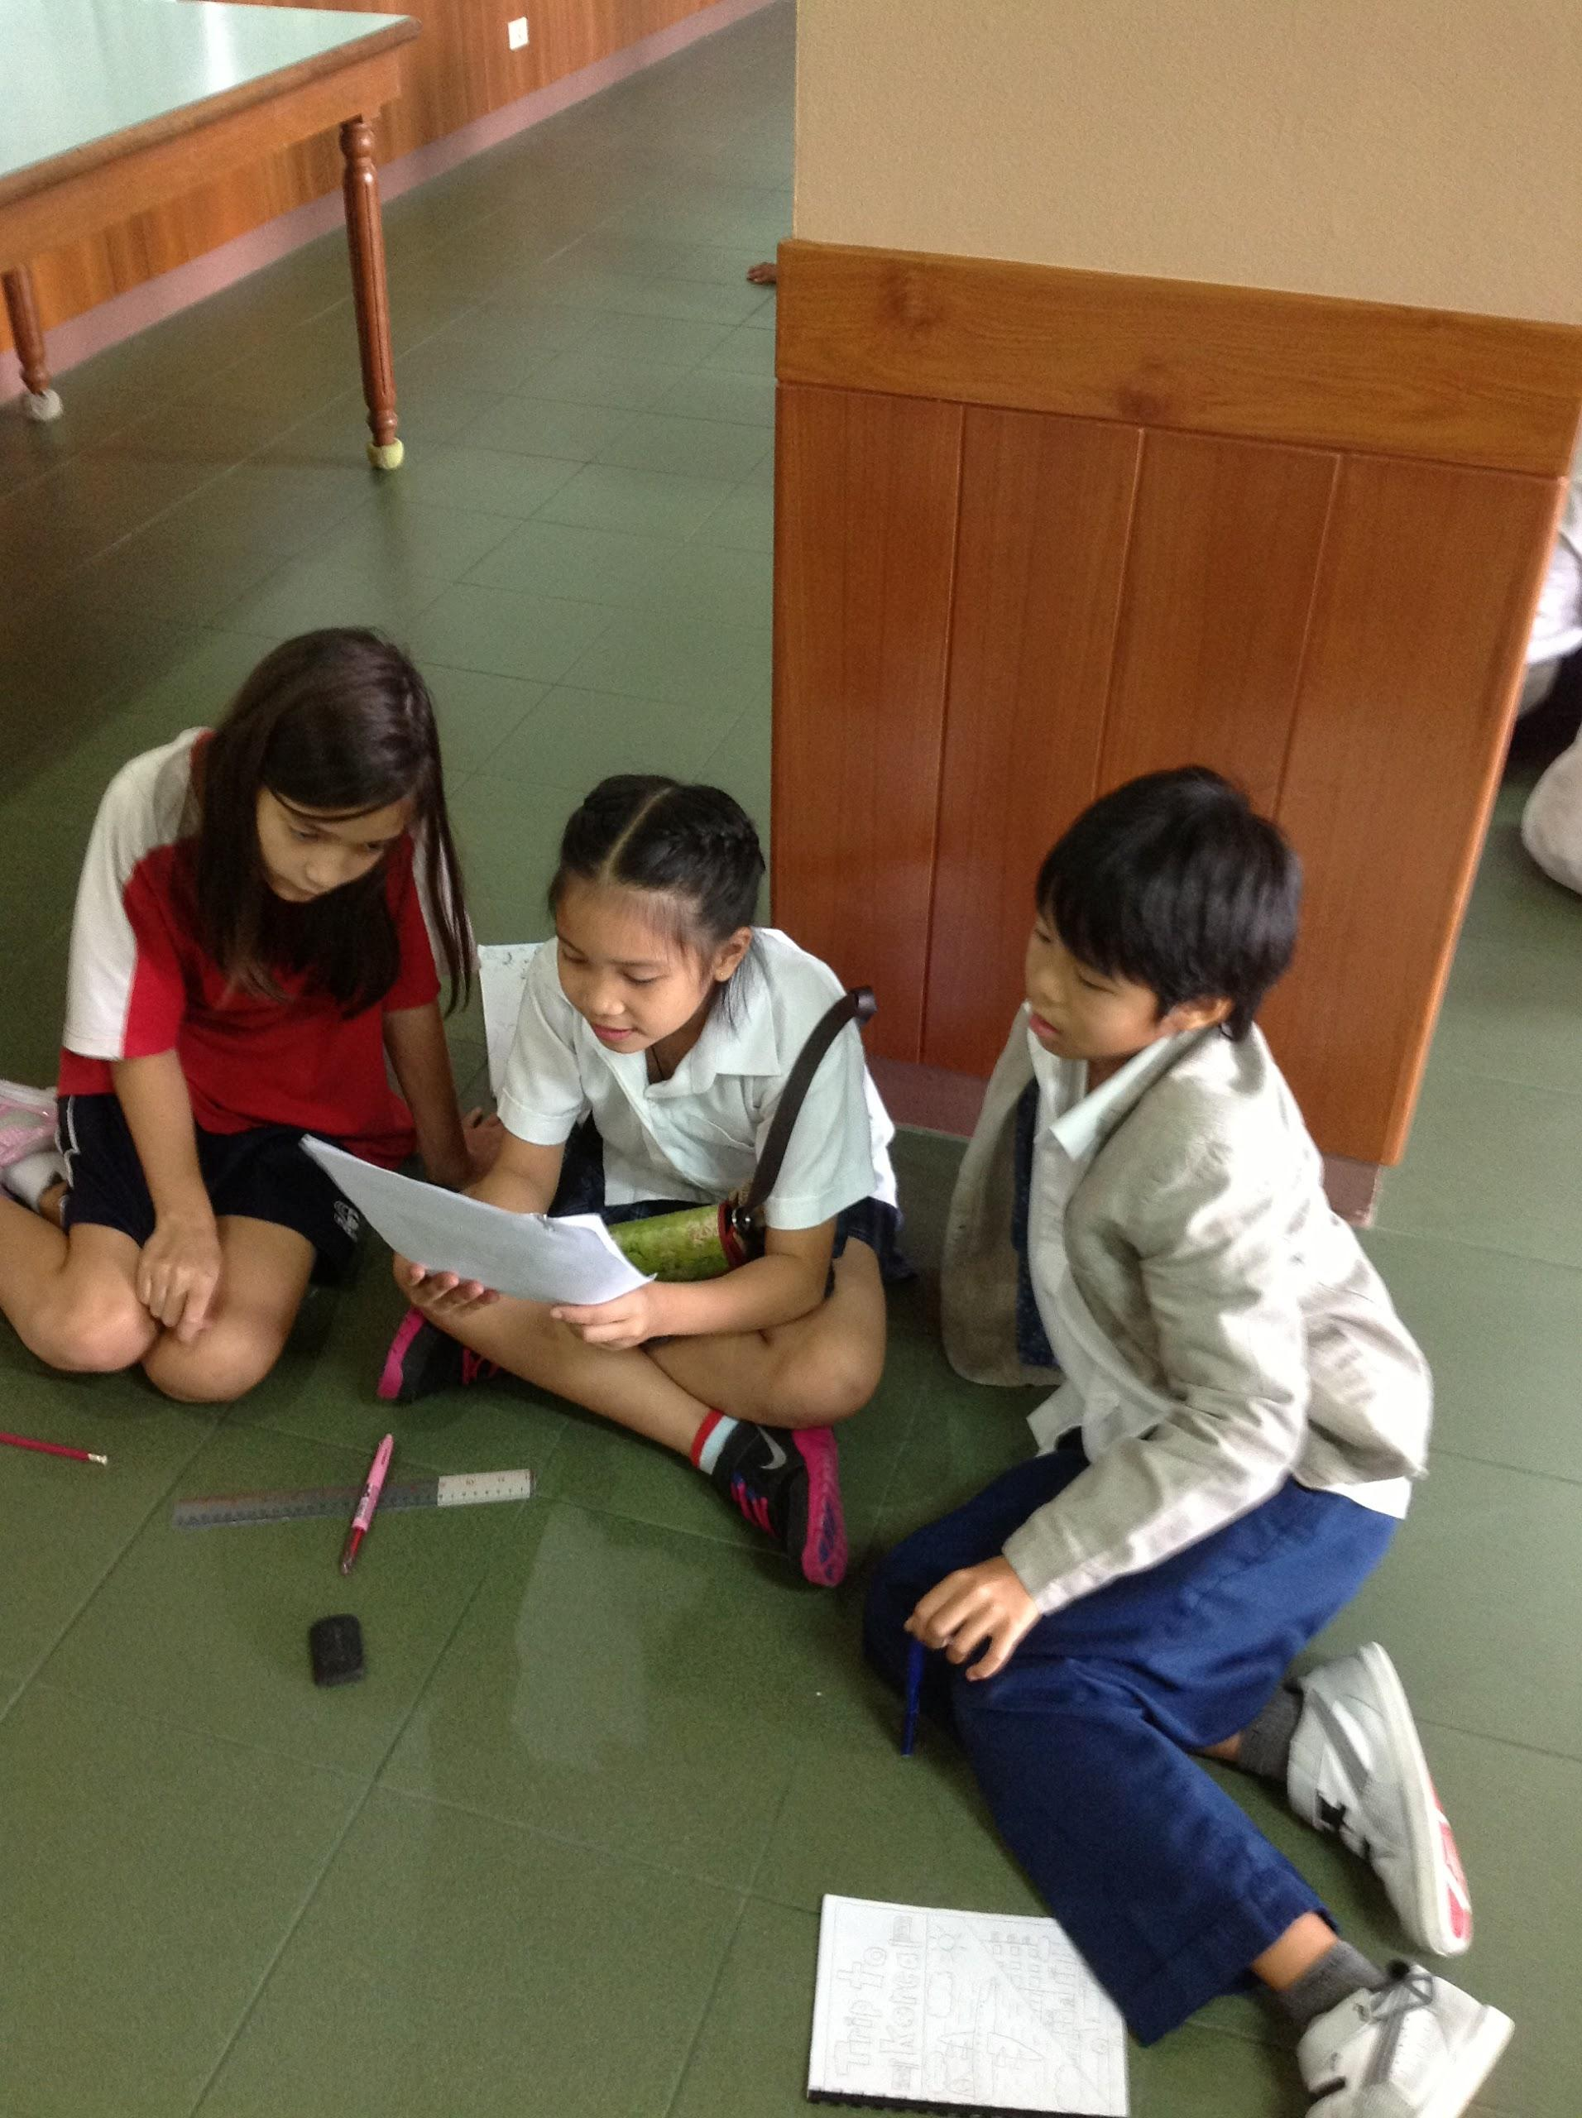
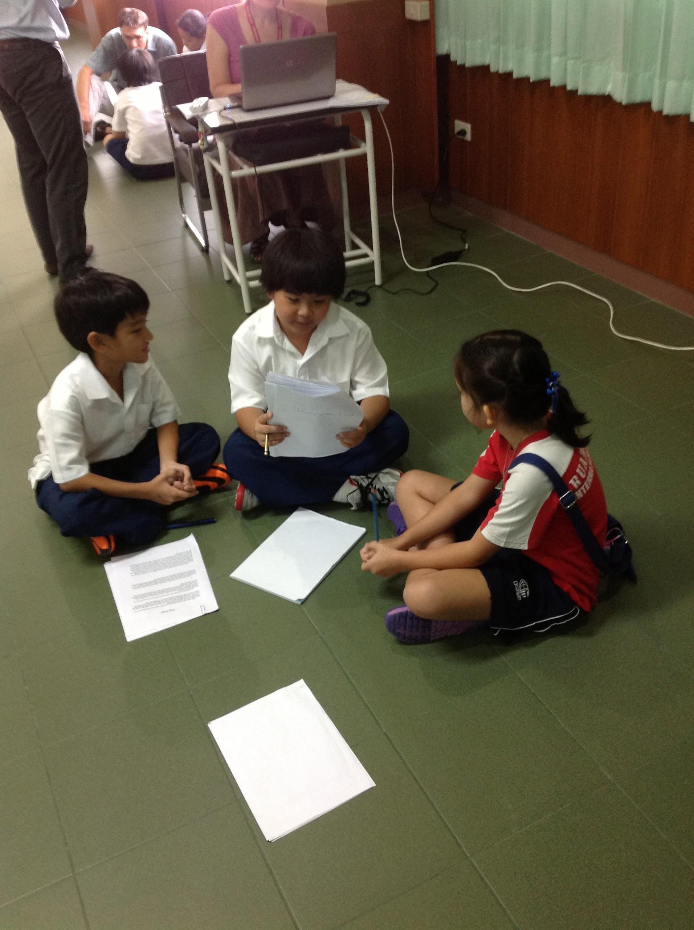
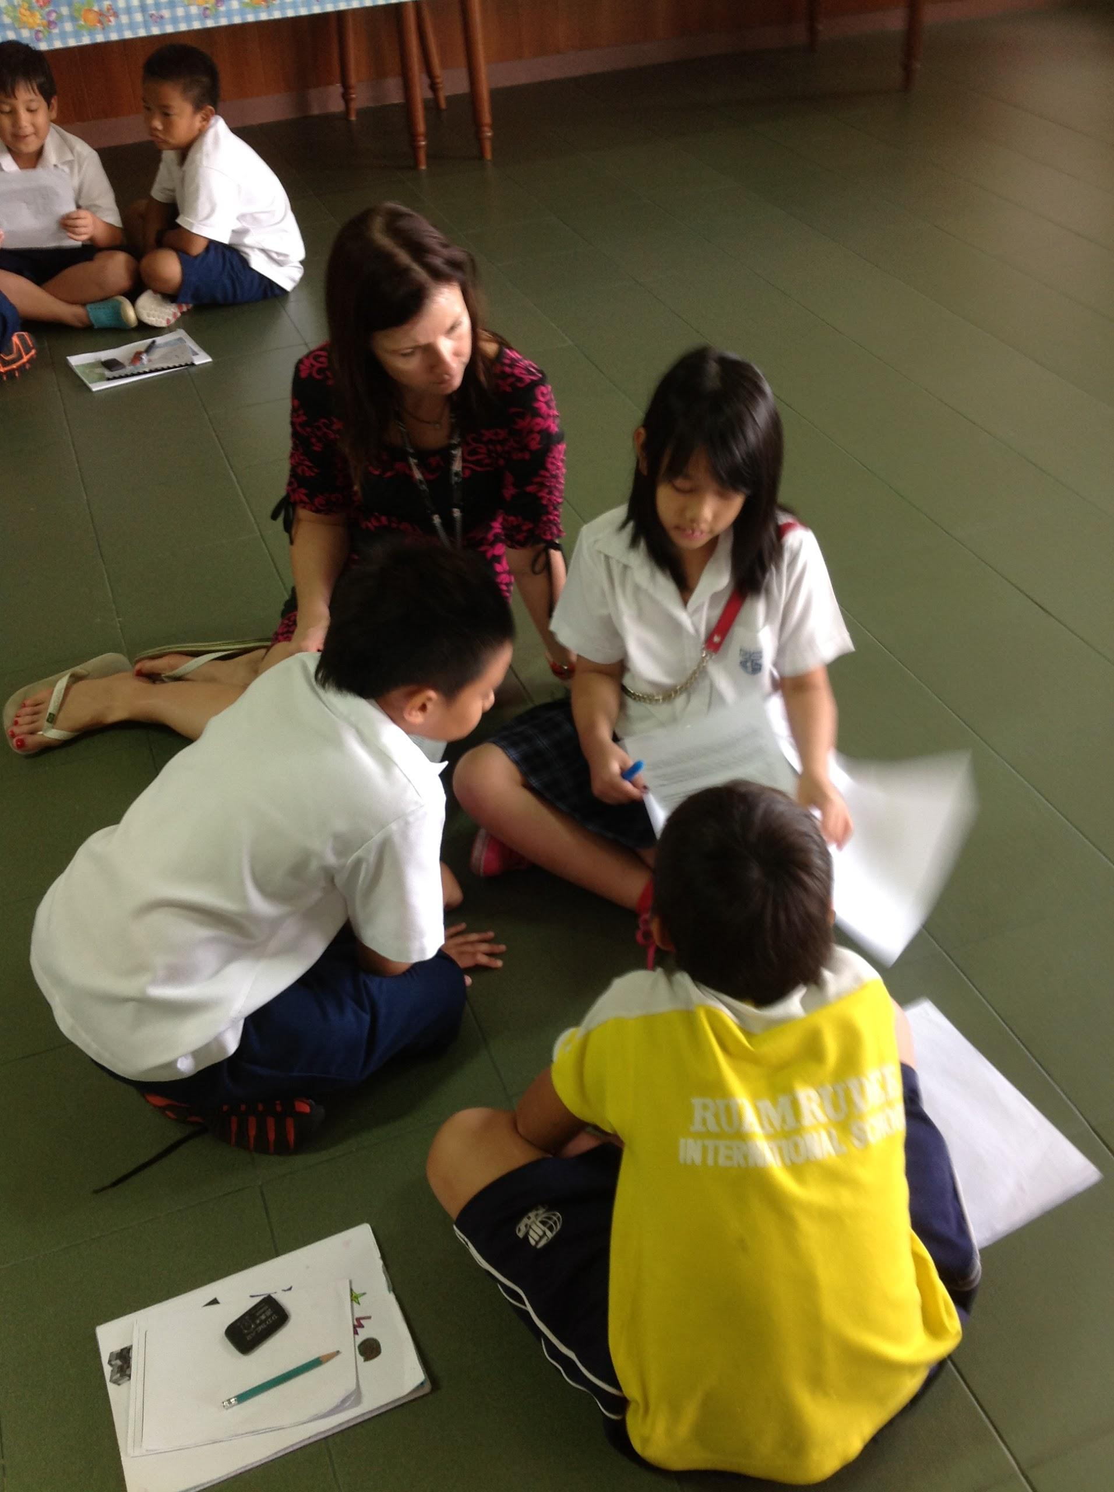

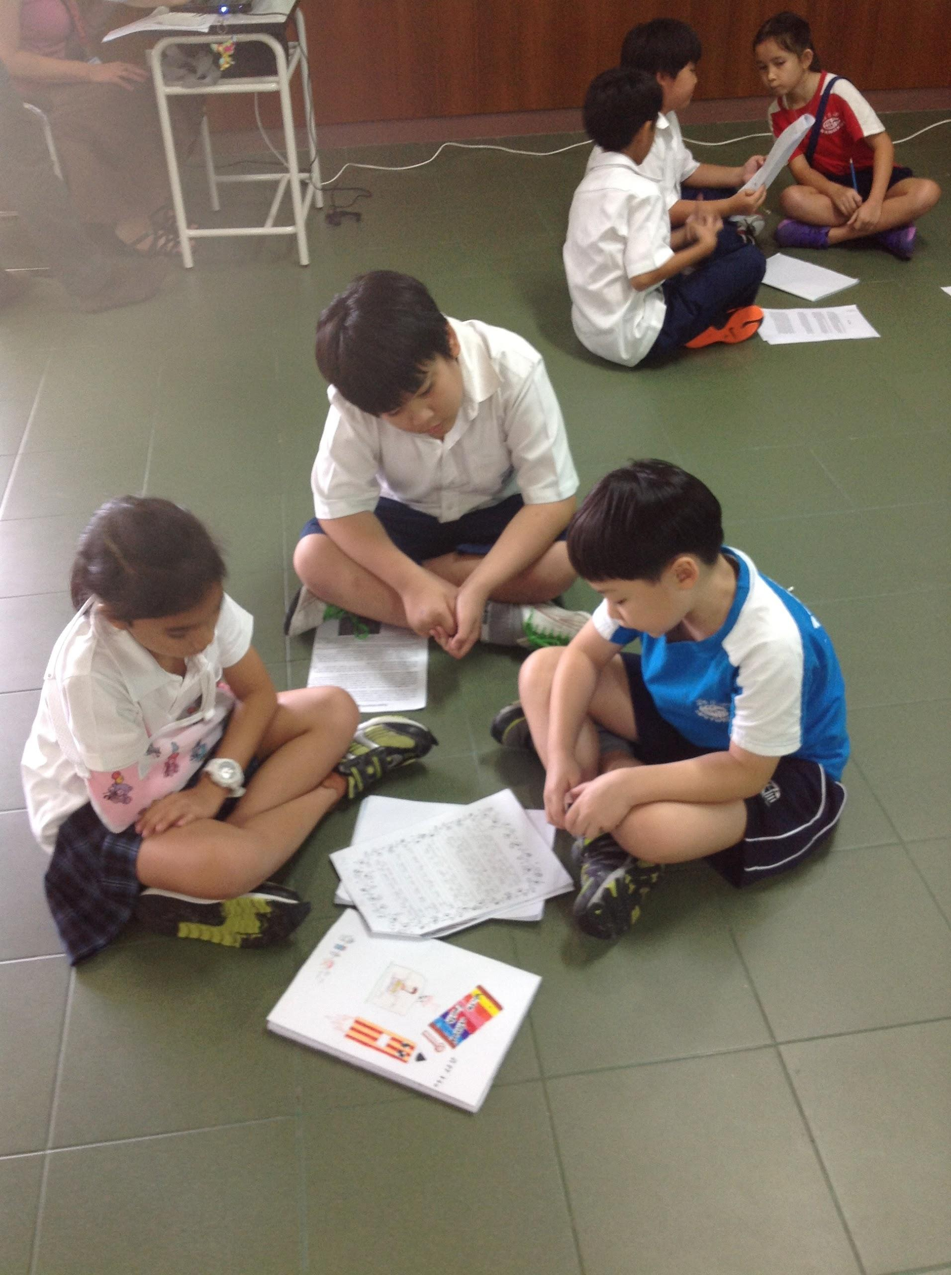
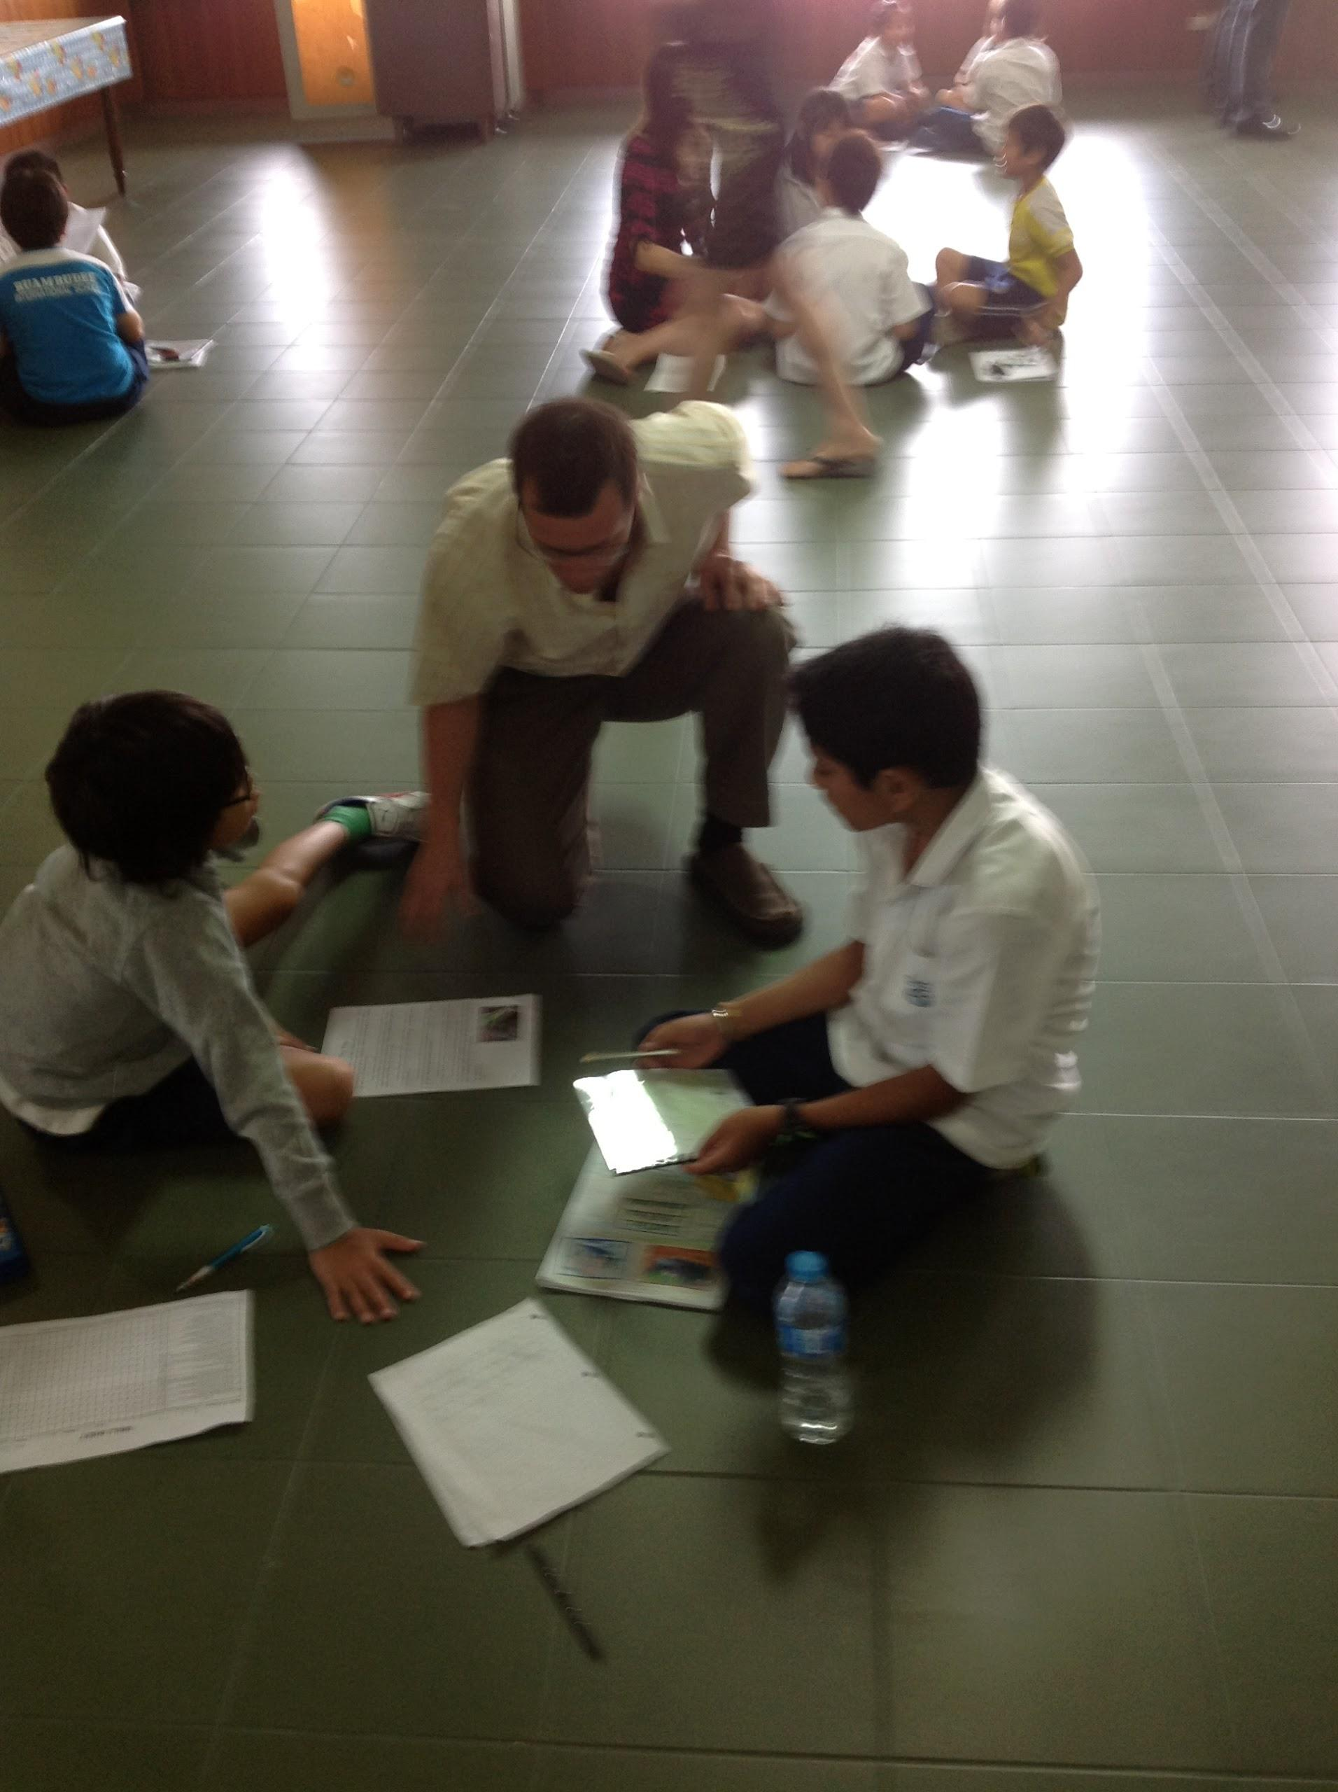
Mrs. Katie's Class 4-2
Celebrating our Writing
Personal Narratives

Slide 9
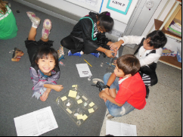
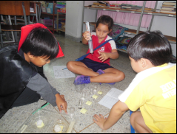
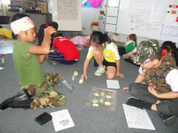
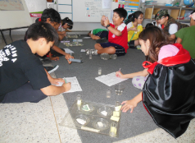
Ms. Jenne’s class—Halloween Calcite Tests: Costumes and Vinegar!

Slide 10
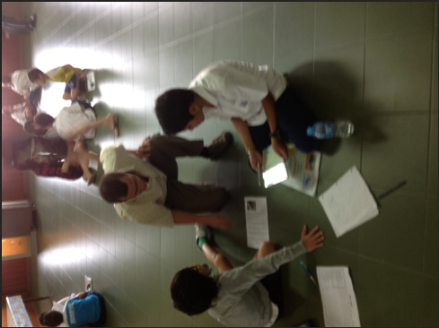
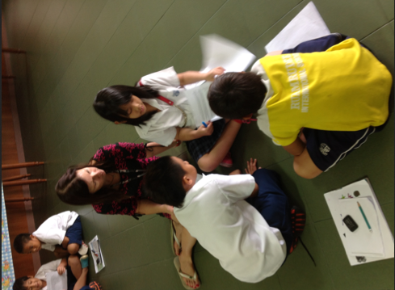
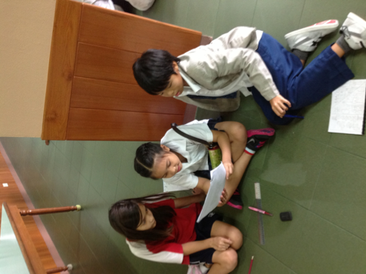
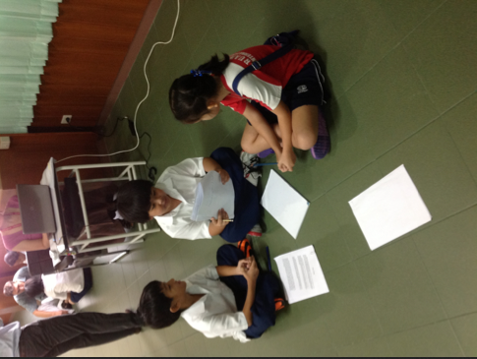
Mr. Joe’s Class
Personal Narrative Writing Celebration!

